Slide 1
ARM PROCESSOR AND
APPLICATION
COURSE PROJECT

Slide 2
Tilte:-
Temperature-Controlled Stepper Motor System for Automated Cooling

Slide 3
TEAM NO:8
NAME | RNO | USN
Sakshi | 636 | 01FE23BEC335
Shivani | 638 | 01FE23BEC337
Arpita | 656 | 01FE23BEC357
Sneha | 622 | 01FE23BEC321

Slide 4
INTRODUCTION
The Temperature-Controlled Stepper Motor System for Automated Cooling is an embedded project developed using the ARM7 LPC2148 microcontroller and Keil IDE. It aims to automatically regulate cooling based on ambient temperature. A temperature sensor (e.g., LM35) continuously monitors the environment, and the sensor's analog data is processed using the LPC2148’s inbuilt ADC. When the temperature exceeds a defined threshold, the microcontroller activates a stepper motor to control a cooling mechanism such as vents or fans. This system offers precise control, energy efficiency, and real-time response, making it ideal for smart cooling applications in industrial and residential settings.

Slide 5
System Behavior:
When temperature rises (heating) → Stepper motor stops.
When temperature falls (cooling) → Stepper motor starts/rotates.

Slide 7
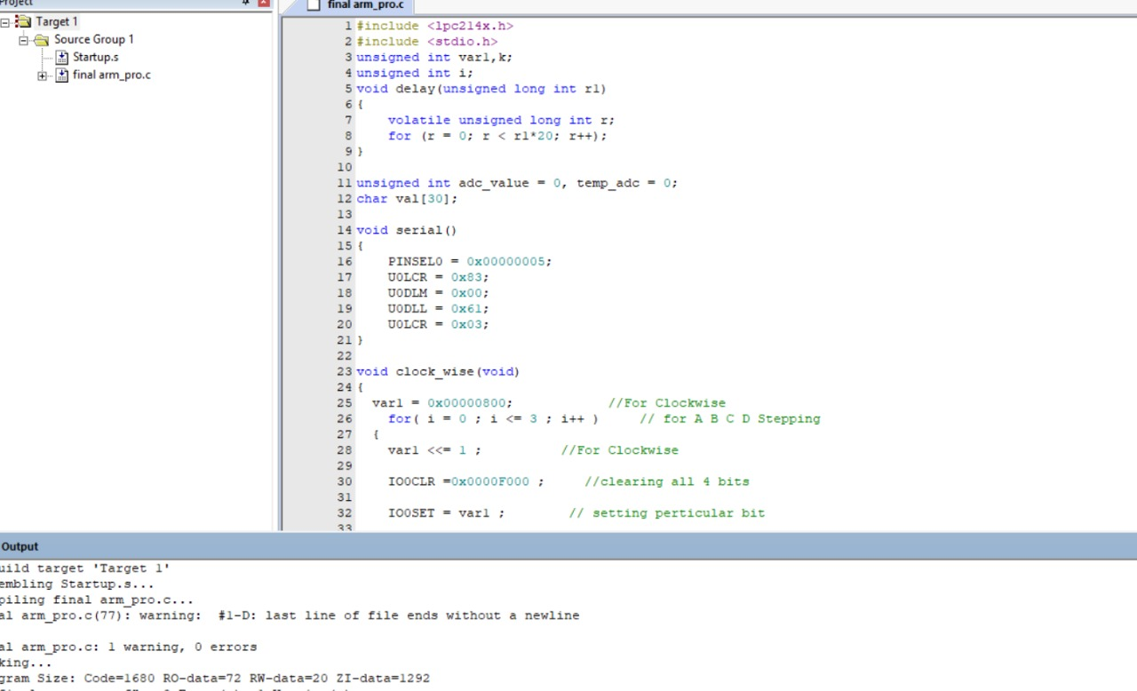
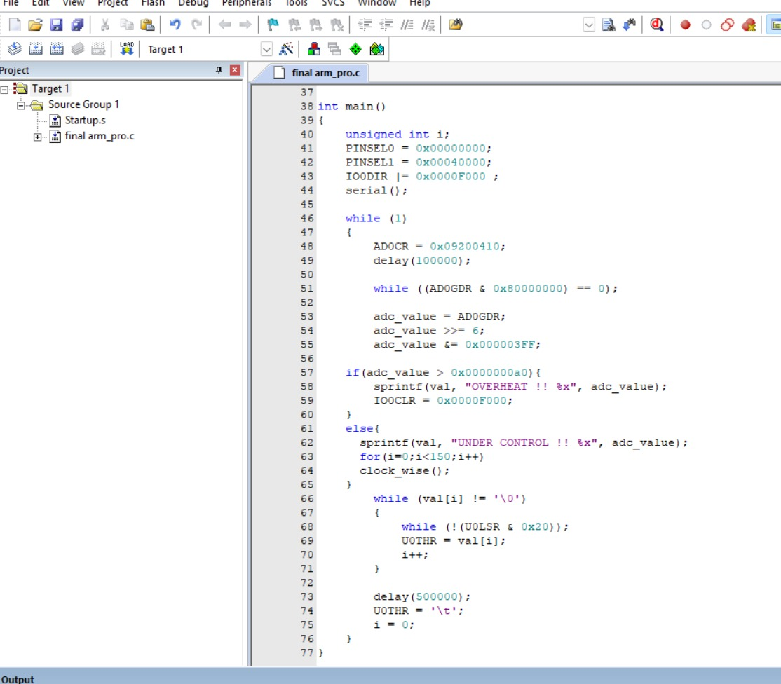
CODE

Slide 8
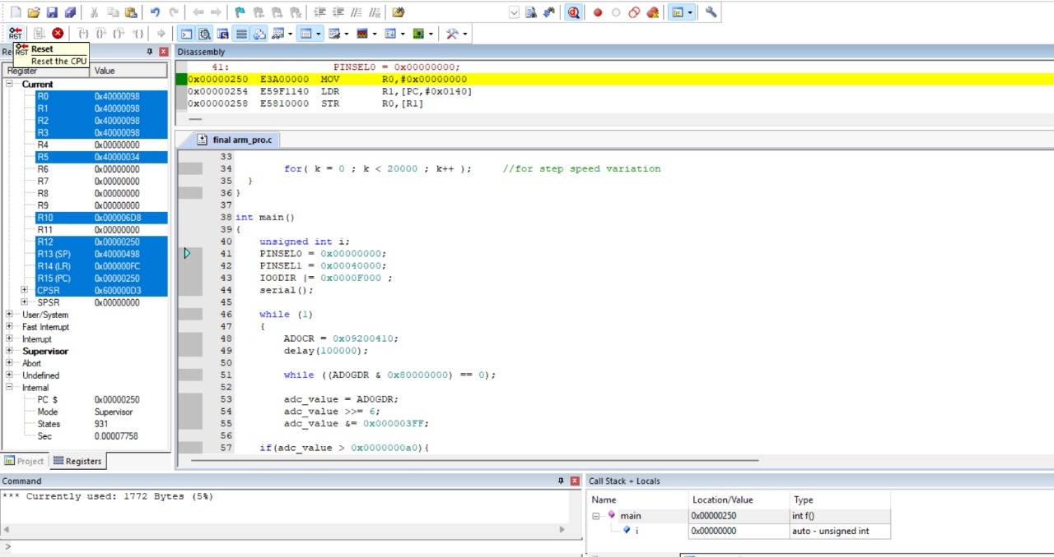

Slide 9

OUTPUT VIDEO

Slide 10
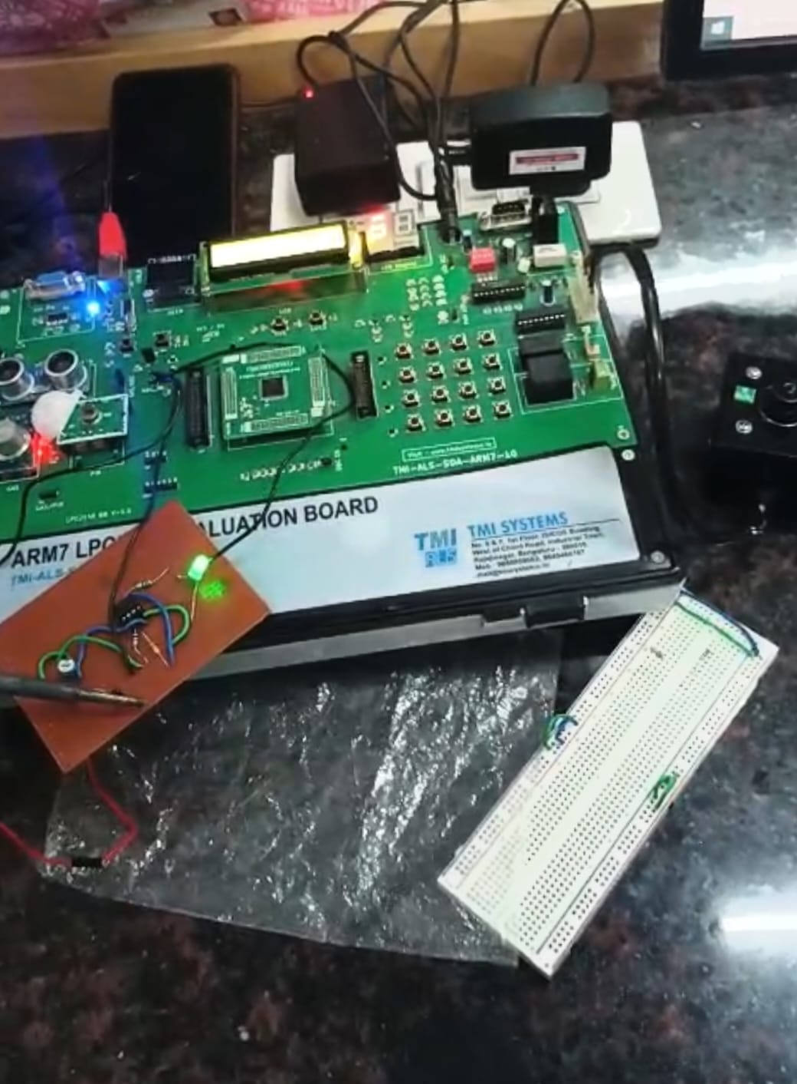
OUTPUT PHOTO

Slide 11
CONCLUSION:
If the temperature rises above the threshold, the controller halts the stepper motor to prevent thermal buildup.Once the temperature drops below the threshold, the controller restarts the motor, allowing motion only under safe thermal conditions.This closed-loop feedback system ensures automated cooling through controlled actuation, enhancing safety and efficiency.

